Slide 1

News Summarization using Deep Learning Approaches
Group Members :
Harsh Sharma - IIT2019097
Tamoghno Bhattacharya - IIT2019103 Gurmeet Singh - IIT2019121 Anurag Bandyopadhyay - IIT2019126 Aamej Shreyansh - IIT2019153
Instructor: Dr. Nabajyoti Mazumdar

Slide 2
Abstract
Due to the exponential increase of databases around the world containing news stories, legal documents, research papers, etc., Automatic Text Summarization (ATS) is becoming more and more relevant. It has several cross-domain applications, such as in natural language understanding and information retrieval, making it a particularly rich subject for research.
In this project we aim to use an extractive approach followed by a pre-trained language model to generate concise, meaningful and exhaustive summaries for our news documents.

Slide 3
USE CASES
Search Engine Optimization
Newsletters
Legal Contract Analysis
Social Media Marketing
Question answering bots
And many more ….
Source: https://www.frase.io/blog/20-applications-of-automatic-summarization-in-the-enterprise/

Slide 4
Introduction
Internet-era resources including websites, blogs, news, user communications, and social networking sites have gathered enormous amounts of textual material and continue to expand daily at a rapid rate.
Thus, information overload is becoming a more serious issue.
Text summarising is a method for identifying the primary ideas in a paper or collection of related materials, retaining their essential points, and extracting the key concepts.
Reduces the time & space needed to read & store the complete document.
We will work on an extractive approach of ATS.

Slide 5
The basic architecture of an ATS system [1] is:-
Pre-processing: We generate a structured representation of the original text using a number of linguistic techniques, such as sentence segmentation, word tokenization, stop-word removal, part-of-speech tagging, stemming etc.
Processing: Using one of the text summarising strategies, we apply one or more processes to the input document(s) to create the summary.
Post-processing: Several problems with the constructed summary sentences, including anaphoras, are fixed before generating the final summary.

Slide 6
Dataset
CNN/Daily Mail Dataset
CNN/Daily Mail is a single-document dataset for summarization of news documents containing stories from CNN and Daily Mail news websites.
Human generated abstractive summaries are also provided for each document.
The corpus has 286,817 training, 13,368 validation and 11,487 testing documents.
The documents in the training set have 766 words, containing an average of 29.74 sentences per document while the summaries have 53 words, containing an average of 3.72 sentences per document.

Slide 7
LITERATURE SURVEY
Automatic text summary started to gain popularity in the 1950s. Luhn et al. [2] created a method to extract significant sentences from text using factors like word and phrase frequency. Edmundson et al. [3] described a paradigm based on key phrases in addition to the typical frequency-dependent weights.
There are three types of ATS - extractive, abstractive and hybrid.
In extractive ATS, the summary is generated by picking entities from the original summary. An intermediate representation of the document is constructed. There are two types of representation - topic and indicator representation.
Topic representation aims to represent the text in terms of the referenced topics. The techniques include frequency driven approaches, topic word approaches, latent semantic analysis, and Bayesian topic models.

Slide 8
LITERATURE SURVEY
Indicator representation aims to map the sentences on the basis of a set of features obtained through feature selection, and pick sentences which are indicative of high content. The techniques include graph methods, probabilistic machine learning methods such as Naive Bayes classifier, and semi-supervised learning.
Abstractive text summarization produces summaries by paraphrasing various sections of the text. The idea is to recognize the main concepts and generate summaries like a human does.
It includes Graph based, Tree based, Rule based, Template based, Ontology based, Semantic based, and Deep Learning based methods. [4]

Slide 9
LITERATURE SURVEY
The generation of large datasets have led to Deep Learning algorithms making use of this huge volume of data for language generation tasks and have led to a revolution in Natural Language Processing. Sequence to Sequence models [5] were introduced in 2014 that were found to be significantly better in terms of machine translation.
However, memorizing long sentences was not feasible for an encoder network.
Vaswani et al. [6] proposed an attention mechanism for machine translation where, for generating the translation of a word the decoder only pays attention to parts of the original sentence and is more representative of the ways humans translate sentences.

Slide 10
LITERATURE SURVEY
The generation of positional encodings, combined with the parallelism of the attention mechanism using a CNN style of processing led to the Transformer architecture [6] which gave a significant performance gain for various natural language tasks.
Pre-trained language models [7,8,9,10,11] have lately been a significant tool for obtaining impressive advances in a wide range of natural language tasks. A new language representation model called Bidirectional Encoder Representation from Transformers (BERT) [9] is trained on a corpus of 3,300M words using masked language modeling and a "next sentence prediction" task.

Slide 11
LITERATURE SURVEY
Since these language models can be used for downstream tasks such as text summarization, many variants of transformer networks with BERT as encoder have been invented and represent the state-of-the-art for the text summarization problem.
Some state-of-the-art models for text summarization include BERT-base [9], Distil-BERT [12], PEGASUS (Pre-training with Extracted Gap Sentences for Abstractive Summarization) [13], BART (Bidirectional Auto-Regressive Transformers) [14] and the T5-Transformer (Text-to-Text Transfer Transformer) [15].

Slide 12
LITERATURE SURVEY
Hybrid methods utilize both extractive and abstractive approaches by combining their advantages.
Among hybrid methods, we have extractive to abstractive methods such as “EA-LTS” [16] which uses a graph model for sentence selection and an RNN-based encoder-decoder with pointer and attention mechanism.
We also have extractive to shallow abstractive methods like “SumItUp” [17]. It basically uses statistical and semantic features for extraction, followed by a language generator.

Slide 13
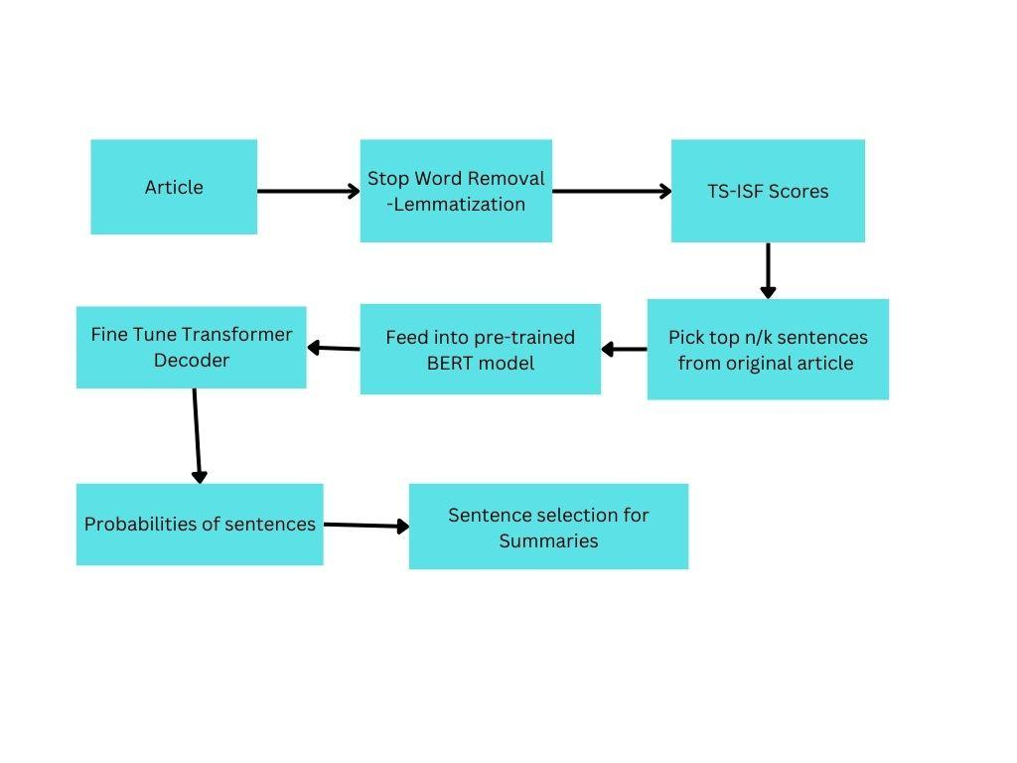
Proposed Methodology
Fig. 1: Flowchart of Proposed Methodology

Slide 14
Proposed Methodology
The problem with transformer-based models is that it is inefficient in language generation tasks involving long documents. Specifically, the average case complexity of transformers is given as O(d*n²) where d is the input embedding dimension and n is the sequence length.
We propose a two-stage extractive approach in which the extractive model picks the top sentences from the document according to a topic representation method using sentence ranking. The selected sentences are then fed into a pre-trained language model for summary generation.
The language model in our case consists of a pre-trained BERT as encoder, with a standard transformer decoder which is pre-trained on a large corpus of documents. The entire model is then evaluated as per the dataset.

Slide 15
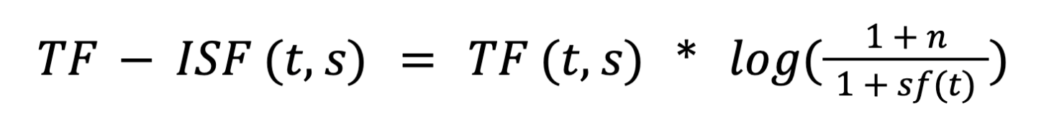
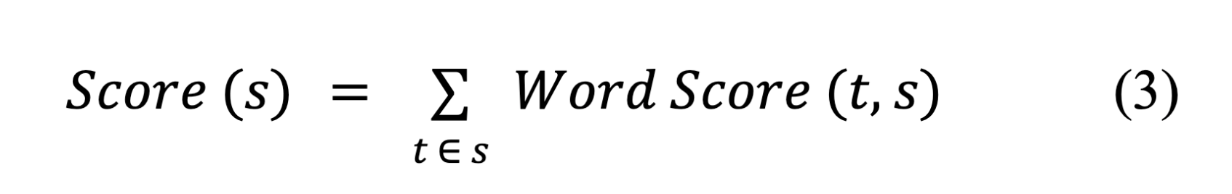
Proposed Methodology
We start with tokenizing the text, performing stop word removal and stemming. For single-document summarization, we calculate the word score using Term Frequency-Inverse Sentence Frequency (TF-ISF) -
(1)
where TF (t,s) is the frequency of word t in sentence s, n is the total number of sentences in a document, and sf (t) is the sentence frequency of t, i.e., the number of sentences in which t occurs. For multi-document summarization, we calculate the Term Frequency-Inverse Document Frequency (TF-IDF) instead.
Our proposed sentence ranking system is as follows -
(2)
The score for a sentence is the summation of TF-ISF values of its words.

Slide 16
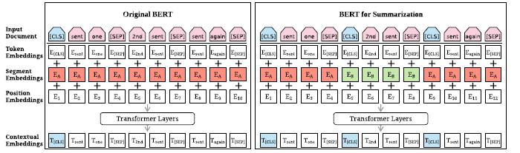
Proposed Methodology
The top n/k sentences are greedily selected using this score and are fed into the transformer model where k is the shrinkage factor. An important feature to note is that the pre-processing steps are only done for the purpose of feature selection.
The extractive model consists of a pre-trained BERT as encoder with a transformer decoder. The architecture of BERTSum [16] is given alongside.
BERTSum is a modification of the BERT architecture with segmentation embeddings and the output vectors generated at sentence levels, which are fed into fine-tuned transformer decoder layers, which output probabilities for the sentence being included in the summary.
We try BERT-base, Distil-BERT and Mobile-BERT [17] as our encoder, with the transformer decoder fine tuned on the specific dataset.
Fig. 2: Architecture of Original BERT (left) vs BERTSUM (right)

Slide 17
Evaluation Metrics
The evaluation of text summarization is a challenging task and a research field in itself. It is complex since computers have to identify the content and phrases that are similar to the human-generated summary and score them based on their similarity.
ROUGE (Recall-Oriented Understudy for Gisting Evaluation) [18] is a series of evaluations designed specifically for ATS and Machine Translation tasks. It compares a machine-generated candidate summary with that of the human references.
The two most widely used variants are ROUGE-N and ROUGE-L.

Slide 18


Evaluation Metrics
ROUGE-N is defined as -
(3)
ROUGE-L is defined as -
(4)
We will be using ROUGE-1, ROUGE-2 and ROUGE-L for evaluation and the results will be presented accordingly.

Slide 19
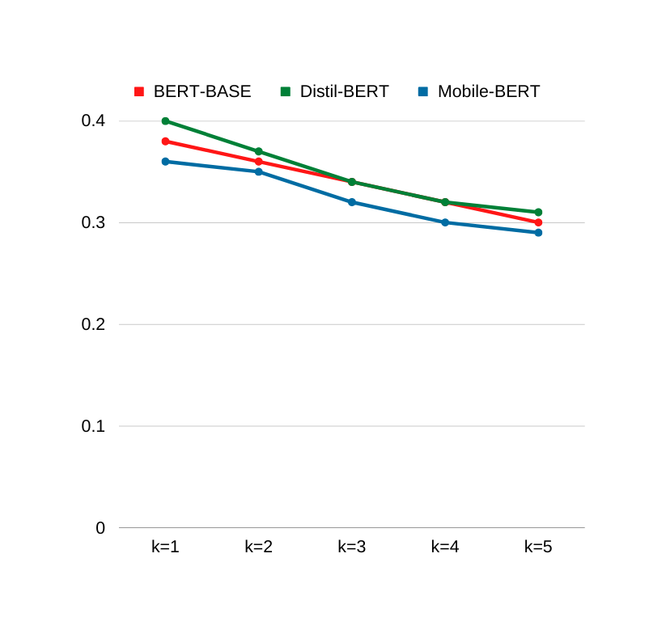
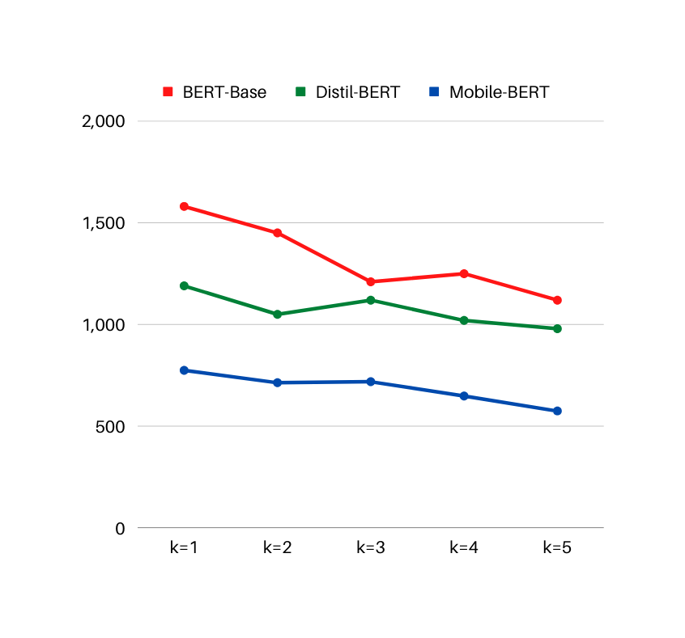
Results
BERT-Base - 2. DistilBERT 3. MobileBERT
k | ROUGE-1 | ROUGE-2 | ROUGE-L | Time (in ms)
1 | 0.38 | 0.17 | 0.36 | 1580
2 | 0.36 | 0.15 | 0.33 | 1450
3 | 0.34 | 0.13 | 0.31 | 1210
4 | 0.32 | 0.12 | 0.29 | 1250
5 | 0.30 | 0.11 | 0.28 | 1120
k | ROUGE-1 | ROUGE-2 | ROUGE-L | Time (in ms)
1 | 0.40 | 0.18 | 0.37 | 1190
2 | 0.37 | 0.15 | 0.34 | 1050
3 | 0.34 | 0.13 | 0.31 | 1120
4 | 0.32 | 0.12 | 0.29 | 1020
5 | 0.31 | 0.11 | 0.28 | 980
k | ROUGE-1 | ROUGE-2 | ROUGE-L | Time (in ms)
1 | 0.36 | 0.15 | 0.33 | 775
2 | 0.35 | 0.14 | 0.32 | 714
3 | 0.32 | 0.12 | 0.30 | 719
4 | 0.30 | 0.11 | 0.28 | 649
5 | 0.29 | 0.10 | 0.26 | 575
Table 1: BERT-Base Comparison
Table 2: DistilBERT Comparison
Table 3: MobileBERT Comparison
Fig. 3: Qualitative curve of ROUGE-1 vs k
Fig. 4: Performance curve of Time taken (in ms) vs k

Slide 20
Results
We performed the qualitative and performance analysis of our model for different values of k(shrinkage hyperparameter). The unit for performance measurement is time in milliseconds to perform a single prediction.
DistilBERT performs the best based on qualitative comparison, whereas MobileBERT performs best in terms of performance comparison.
K represents a tradeoff between the summary quality and performance of the model. Increasing the value of k results in shorter input summaries to the BERT model, hence resulting in better performance however the decreased input content results in decrease in quality of output summaries.

Slide 21
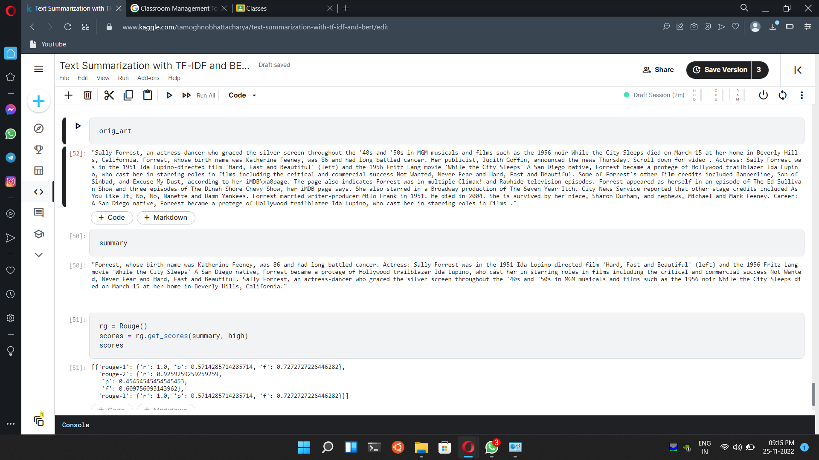
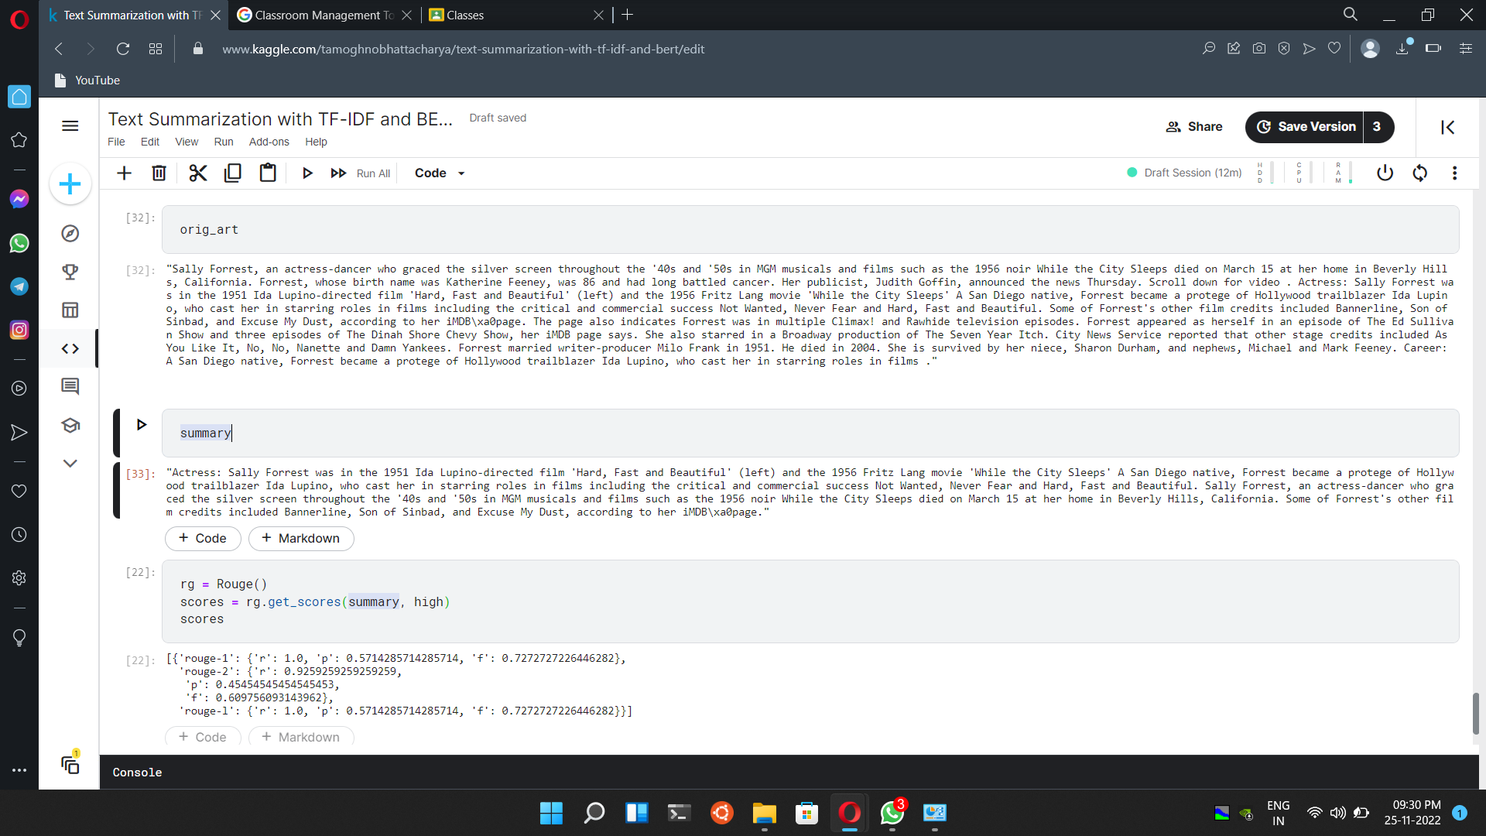
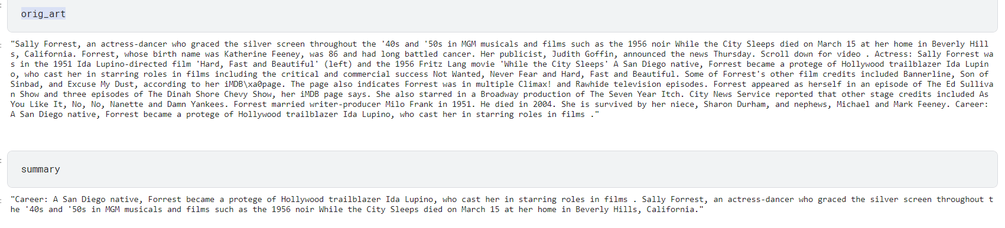
Results
For k = 2, For k = 3,
For k = 4,
Fig. 5: Summary generated for k = 2
Fig. 6: Summary generated for k = 3
Fig. 7: Summary generated for k = 4

Slide 22
Results
We explore the quality of summaries generated for different articles by varying the value of k used and we find that the quality starts dipping rapidly from k = 3 onwards.
Using these observations, we propose using a value of k = 2 as the optimal value of k which balances quality and performance of summarization.

Slide 23
References
El-Kassas, Wafaa & Salama, Cherif & Rafea, Ahmed & Mohamed, Hoda. (2020). Automatic Text Summarization: A Comprehensive Survey. Expert Systems with Applications. 165. 113679. 10.1016/j.eswa.2020.113679.
H. P. Luhn, ``The automatic creation of literature abstracts,'' IBM J. Res. Develop., vol. 2, no. 2, pp. 159165, Apr. 1958.
Edmundson, H.P. (1969) New Methods in Automatic Extracting. Journal of the ACM (JACM), 16, 264-285. https://doi.org/10.1145/321510.321519
Moratanch, N. & Chitrakala, (2017). A Survey on Extractive Text Summarization.Paper presented at the International Conference on Computer,Communication and Signal Processing (ICCCSP), Chennai.
Sutskever, Ilya & Vinyals, Oriol & Le, Quoc. (2014). Sequence to Sequence Learning with Neural Networks. Advances in Neural Information Processing Systems. 4.
Vaswani, Ashish, Noam Shazeer, Niki Parmar, Jakob Uszkoreit, Llion Jones, Aidan N. Gomez, Łukasz Kaiser, and Illia Polosukhin. "Attention is all you need." Advances in neural information processing systems 30 (2017).

Slide 24
References
Matthew Peters, Mark Neumann, Mohit Iyyer, Matt Gardner, Christopher Clark, Kenton Lee, and Luke Zettlemoyer. 2018. Deep contextualized word representations. In Proceedings of the 2018 Conference of the North American Chapter of the Association for Computational Linguistics: Human Language Technologies, Volume 1 (Long Papers), pages 2227–2237, New Orleans, Louisiana.
Alec Radford, Karthik Narasimhan, Tim Salimans, and Ilya Sutskever. 2018. Improving language understanding by generative pre-training. In CoRR, abs/1704.01444, 2017.
Jacob Devlin, Ming-Wei Chang, Kenton Lee, and Kristina Toutanova. 2019. BERT: Pre-training of deep bidirectional transformers for language understanding. In Proceedings of the 2019 Conference of the North American Chapter of the Association for Computational Linguistics: Human Language Technologies, Volume 1 (Long and Short Papers), pages 4171–4186, Minneapolis, Minnesota.
Li Dong, Nan Yang, Wenhui Wang, Furu Wei, Xiaodong Liu, Yu Wang, Jianfeng Gao, Ming Zhou, and Hsiao-Wuen Hon. 2019. Unified language model pre-training for natural language understanding and generation. arXiv preprint arXiv:1905.03197.
Xingxing Zhang, FuruWei, and Ming Zhou. 2019. HIBERT: Document level pre-training of hierarchical bidirectional transformers for document summarization. In Proceedings of the 57th Annual Meeting of the Association for Computational Linguistics, pages 5059–5069, Florence, Italy. Association for Computational Linguistics.

Slide 25
References
Sanh, Victor, Lysandre Debut, Julien Chaumond, and Thomas Wolf. "DistilBERT, a distilled version of BERT: smaller, faster, cheaper and lighter." arXiv preprint arXiv:1910.01108 (2019).
Zhang, Jingqing, Yao Zhao, Mohammad Saleh, and Peter Liu. "Pegasus: Pre-training with extracted gap-sentences for abstractive summarization." In International Conference on Machine Learning, pp. 11328-11339. PMLR, 2020.
Lewis, Mike & Liu, Yinhan & Goyal, Naman & Ghazvininejad, Marjan & Mohamed, Abdelrahman & Levy, Omer & Stoyanov, Veselin & Zettlemoyer, Luke. (2020). BART: Denoising Sequence-to-Sequence Pre-training for Natural Language Generation, Translation, and Comprehension. 7871-7880. 10.18653/v1/2020.acl-main.703.
Raffel, Colin & Shazeer, Noam & Roberts, Adam & Lee, Katherine & Narang, Sharan & Matena, Michael & Zhou, Yanqi & Li, Wei & Liu, Peter. (2019). Exploring the Limits of Transfer Learning with a Unified Text-to-Text Transformer.
Liu, Yang & Lapata, Mirella. (2019). Text Summarization with Pretrained Encoders.
Wang, S., Zhao, X., Li, B., Ge, B. & Tang, D. (2017). Integrating extractive and abstractive models for long text summarization. Paper presented at the 2017 IEEE International Congress on Big Data (BigData Congress).
Lin, Chin-Yew. (2004). ROUGE: A Package for Automatic Evaluation of summaries. Proceedings of the ACL Workshop: Text Summarization Braches Out 2004. 10.

Slide 26
THANK YOU !

